Slide 1
FIN 615-F Financial Decision Making
Content: Introduction of 21 F-FIN-615F
09/01/2021
Ji Sui
School of Business
Stevens Institute of Technology

Slide 2
Welcome to FIN 615 F Financial Decision Making!
Introduction of FIN615 F Financial Decision Making
E.g. What’s the goal of this course?
What will you get from this course?
… …

Slide 3
Welcome to FIN 615 F Financial Decision Making!
Perquisition:
Hands-up if you have accounting/ finance/ business related background!
Goal of this class:
Not only basic accounting and finance terms, definitions, and calculation.
Provide you a toolbox to collect, analyze, and making business decision
Vivid case studies as well!
Syllabus

Slide 4
Introduction of this course
Course Time & Office Hour:
Course Time: Wednesday 12:00 PM to 2:30 PM
Office Hour: Tuesday 1:00 pm - 2: 00 pm, Thursday 1:00 pm- 2:00 pm or by appointment
Textbook:
Managerial Accounting, Fourth Edition Karen W. Braun, Case Western Reserve University Wendy M. Tietz, Kent State University Pearson; ISBN: 9780133428377
Homework & Exam:
6 homework and 2 exams (Mid-term and Final)
Stop by during office hours or send me an email for any question!

Slide 5
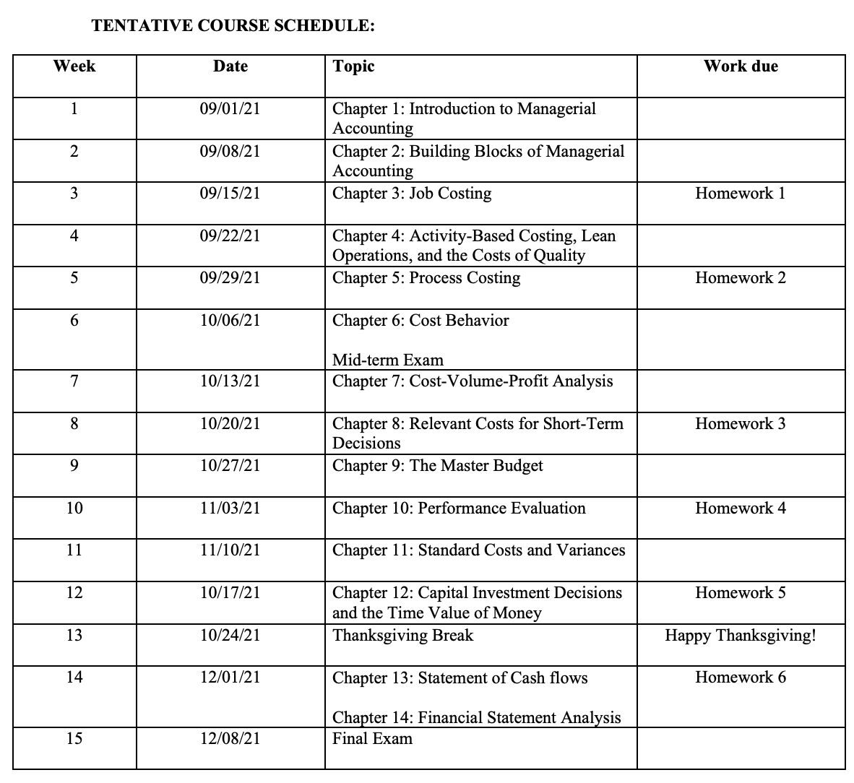
Course schedule Chapter 1 & 2 Chapter 3,4, and 5 Chapter 6 & 7 Chapter 8 &12 Chapter 9 Chapter 10 & 11 Chapter 13 &14

Slide 6
6

